Slide 1
DESIGN AND IMPLEMENTATION OF AN ONLINE COURSE EVALUATION SYSTEM (CASE STUDY OF FEDERAL UNIVERSITY, DUTSE. JIGAWA STATE.) BY UMAR HAMZA ADAM FCP/CSC/18/1022
PRESENTING TO THE DEPARTMENT OF COMPUTER SCIENCE, FACULTY OF COMPUTING, FEDERAL UNIVERSITY DUTSE, JIGAWA STATE, NIGERIA IN PARTIAL FULFILMENT OF THE REQUIREMENT FOR THE AWARD OF BACHELOR OF SCIENCE (B.SC) DEGREE IN COMPUTER SCIENCE.

Slide 2
CHAPTER ONE: INTRODUCTION TO THE STUDY;
The development of an Online Course Evaluation System is essential for Federal University Dutse to collect valuable feedback from students and improve the quality of education. With the proposed methodology and deliverables, in view on the aforementioned paragraphs, I wish to contribute to the enhancement of the university's educational experience.

Slide 3
CHAPTER TWO: LITERATURE REVIEW;
This chapter has provided an overview of literature related to Online Course Evaluation Systems, emphasizing their evolution, benefits, challenges, and limited exploration within the Nigerian university context. The subsequent chapters will delve into the methodology, design, and implementation of an OCES at Federal University Dutse, considering the unique factors that shape the academic environment

Slide 4
CHAPTER THREE: SYSTEM ANALYSIS AND DESIGN;
This chapter has helped us understand how important it is to choose the right IDE, programming language, database, and operating system for the proposed system. The new system must be available and have some new features in order to solve all of the problems with the old and comparable systems. With the right software, however, developers can create a system that meets all user requirements. While managing their system to save, share, or conduct course evaluations for it to be very effective and efficient system helps target users and makes it simpler for them, developers have quickly discussed all the software that an online course evaluation system needs to gain target fulfilment.

Slide 5
CHAPTER FOUR: SYSTEM IMPLEMENTATION AND TESTING;
The present study, entitled "Design and Implementation of an Online course evaluation System: A Case Study of Federal University, Dutse," aims to overcome the drawbacks of conventional lecturer assessment techniques by presenting an Online course evaluation System (OCES) that is optimized for Federal University, Dutse. The project starts with a thorough examination of the current evaluation techniques, which is followed by a review of the literature to lay the theoretical groundwork. The goal of the design phase is to provide an intuitive system with functions like automated reminders and real-time feedback. Modern web technologies are used throughout the implementation phase to guarantee data security and scalability. The project assesses OCES's influence on the lecturer assessment procedure at FUD through a case study, examining indicators such as response rates and user satisfaction. The results offer insightful information to organizations thinking about making comparable advancements. In the end, OCES is in line with FUD's dedication to scholarly achievement by providing a customized solution for improved lecturer evaluation in higher education.

Slide 6
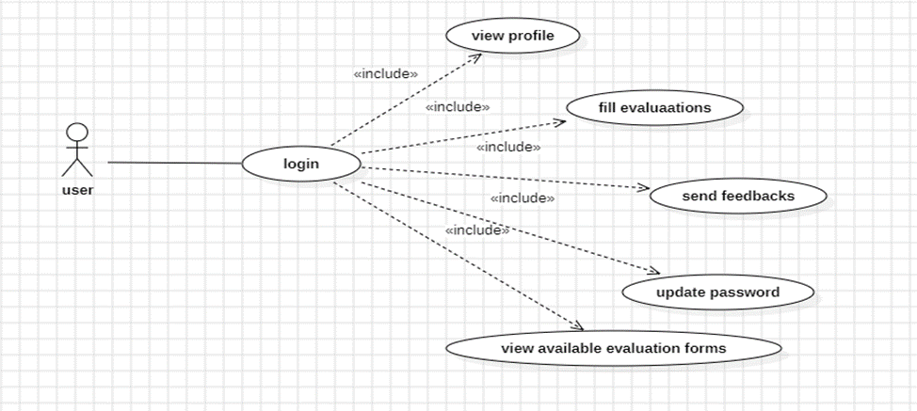
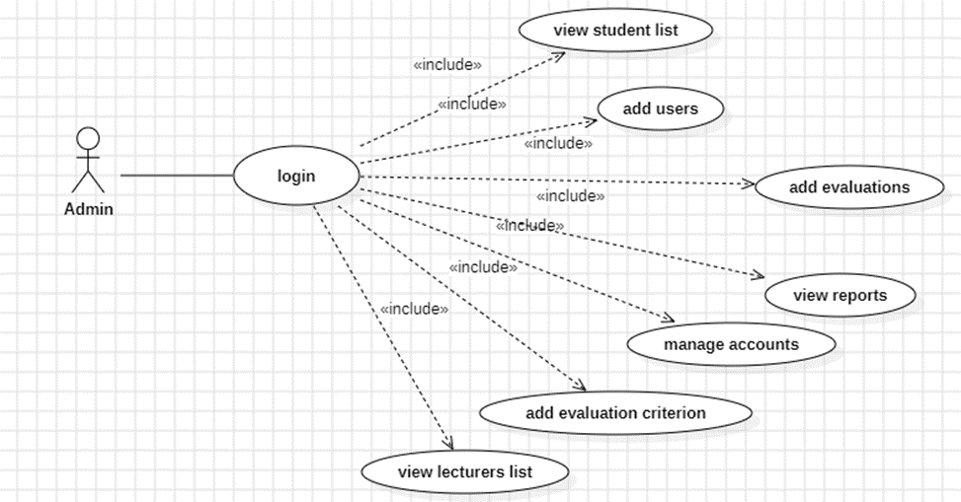
USE-CASE ILLUSTRATION OF THE SYSTEM
For user:
For admins:

Slide 7
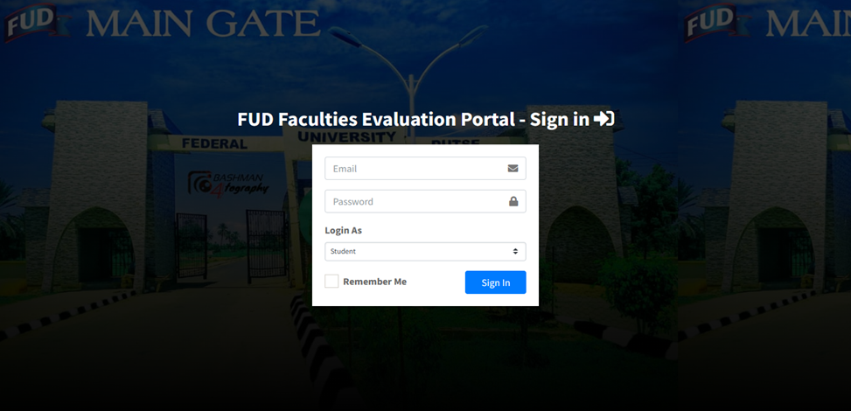
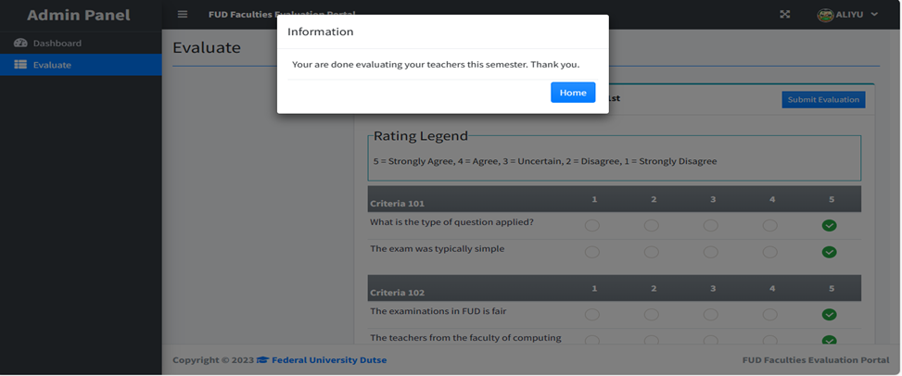
DESCRIPTION OF THE IMPLEMENTED SYSTEM
login page:
evaluation page:

Slide 8
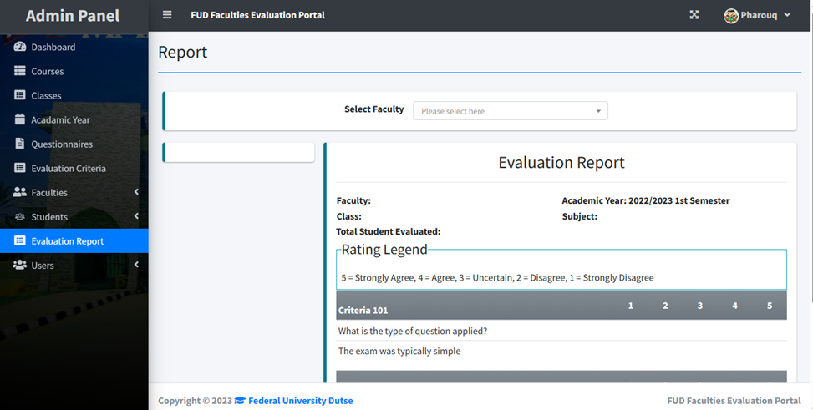
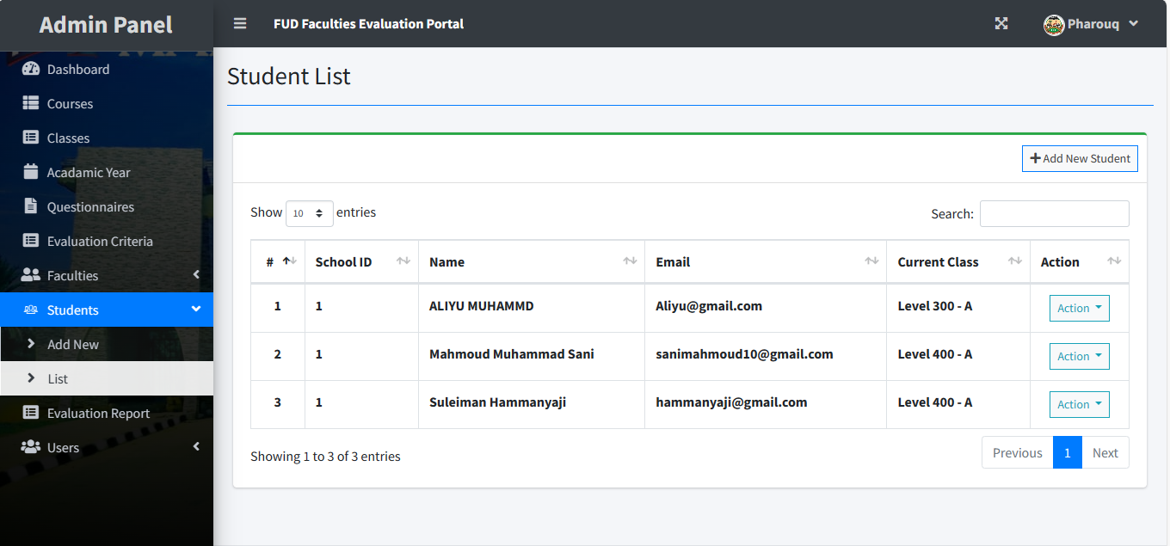
DESCRIPTION OF THE IMPLEMENTED SYSTEM
Evaluation report page:
Students list:

Slide 9
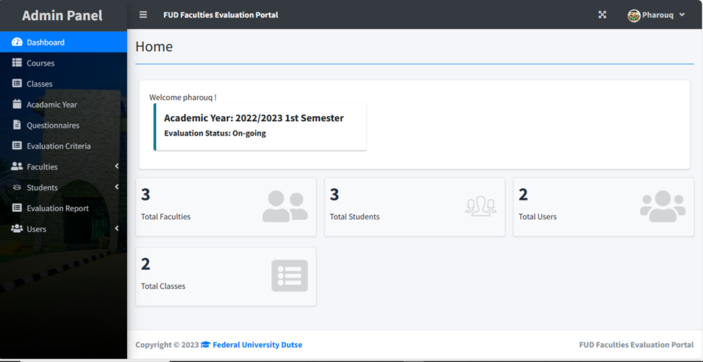
Admin panel:

Slide 10
CONCLUSION:
In conclusion, Federal University, Dutse (FUD) has made a substantial advancement in the efficacy and efficiency of lecturer assessment procedures with the successful design and implementation of the Online Course Evaluation System (OCES). Through the application of contemporary technology, OCES addresses the drawbacks of conventional approaches and offers a user-friendly platform with solid data security, automated processes, and real-time feedback. OCES has a favourable impact on response rates and user happiness, as demonstrated by the case study at FUD. The project's findings provide insightful information for educational institutions looking to improve the efficiency of their professor evaluation processes. OCES is a model for comparable developments in higher education and complements FUD's dedication to academic quality. In the future, OCES's ongoing development and application will support a culture of ongoing enhancement in lecturer evaluation, creating a setting that supports high-quality instruction and learning. This project serves as evidence of the revolutionary potential 35 of technology to improve academic procedures and emphasizes the significance of modifying creative solutions to satisfy the changing requirements of higher education establishments.

